Slide 1
BFX-UA300
RGMII CLK/RXData measurement

Slide 2
Outline
Measure point
NG and Good PCBA waveform compare
SOC delay window compare
Conclusion
Update the test results

Slide 3
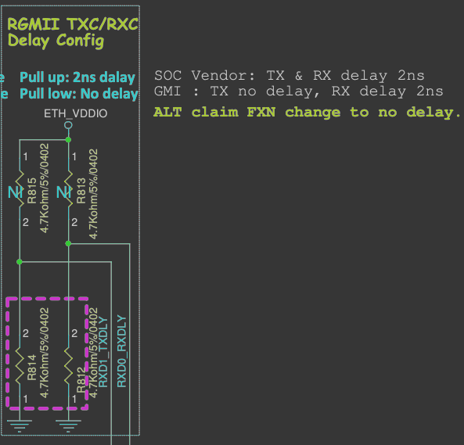
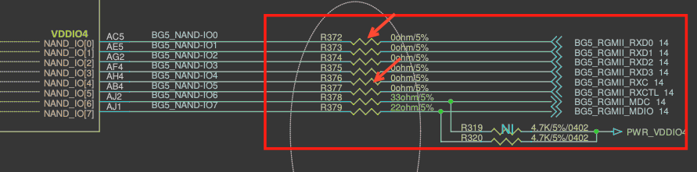
Measure point
RX data and clock of RGMII near SOC side.
  Suggested by Synaptics for checking end of PHY IC to SOC.
SOC side: R372: RXD0, R376: RXC
PHY side: R813 pull-high for RX delay resistor.

Slide 4
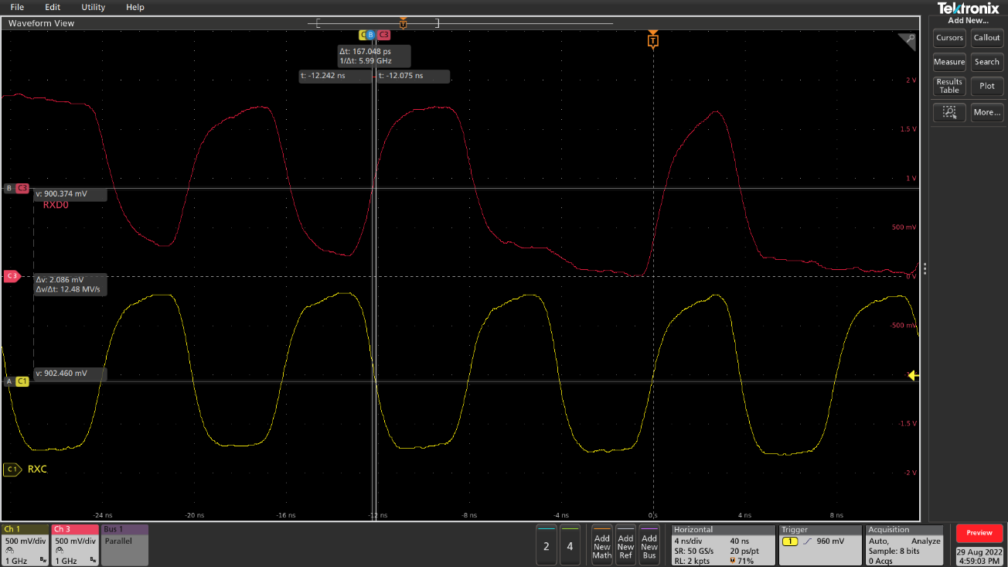

NG and Good PCBA waveform compare(1/4)
No.1 NG IC rework onto good PCBA
  External RX delay is 0ns
  No.1 NG IC+Good PCBA: Data & clock has 167ps shift (Has CRC error)
  OK IC+Good PCBA: Data & clock has 132ps shift (No CRC error)
NO.1 NG IC+Good PCBA
OK IC+Good PCBA

Slide 5
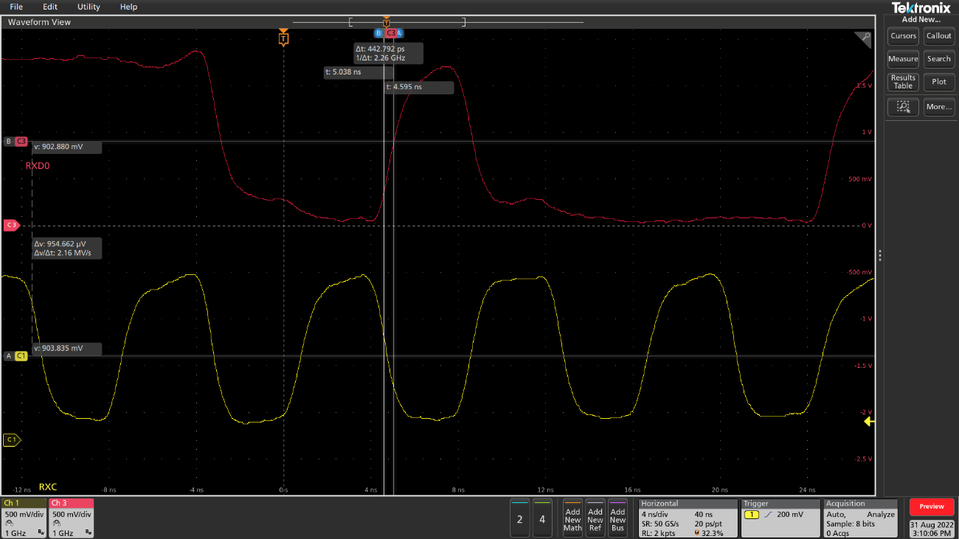
NG and Good PCBA waveform compare(2/4)
No.2 NG IC rework onto good PCBA
  External RX delay is 0ns
  NO.2 NG IC+Good PCBA: Data & clock has 442ps shift (Has CRC error)
  OK IC+Good PCBA Data & clock has 132ps shift (No CRC error)
NO.2 NG IC+Good PCBA
OK IC+Good PCBA

Slide 6
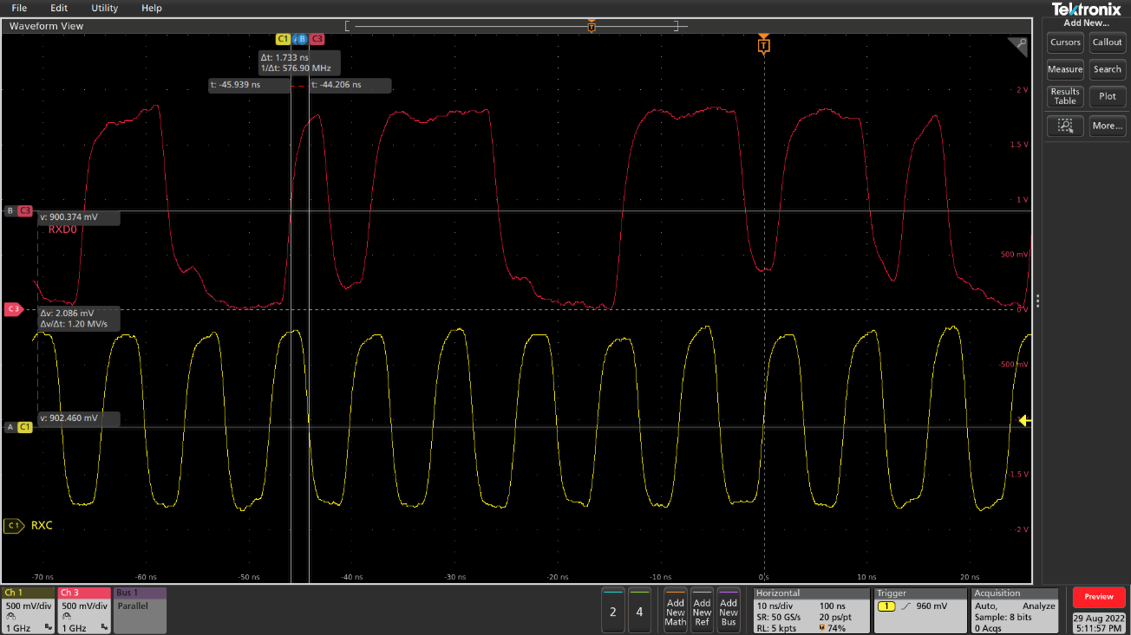
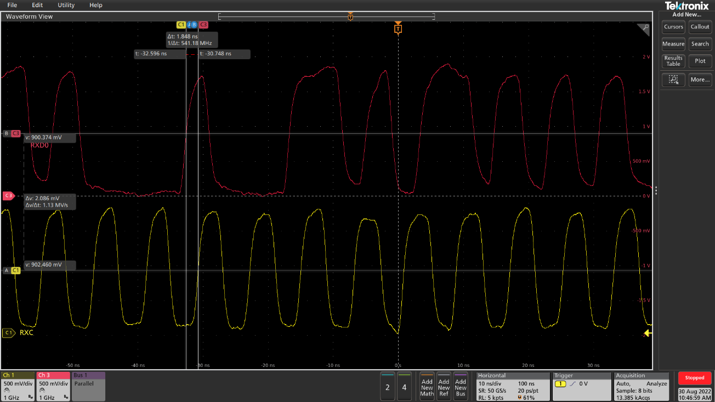
NG and Good PCBA waveform compare(3/4)
No.1 NG IC rework onto good PCBA
  External RX delay is 2ns
  NO.1 NG IC+Good PCBA: Data & clock has 1.733ns shift (Has CRC error)
  OK IC+Good PCBA Data & clock has 1.848ns shift (Has CRC error)
NO.2 NG IC+Good PCBA
OK IC+Good PCBA

Slide 7
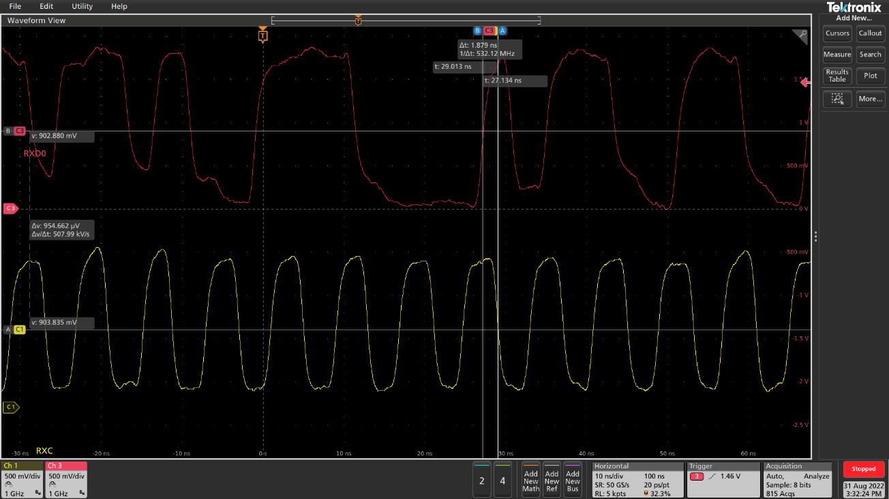
NG and Good PCBA waveform compare(4/4)
No.2 NG IC rework onto good PCBA
  External RX delay is 2ns
  No.2 NG IC+Good PCBA: Data & clock has 1.879ns shift (Has CRC error)
  OK IC+Good PCBA Data & clock has 1.848ns shift (Has CRC error)
No.2 NG IC+Good PCBA
OK IC+Good PCBA

Slide 8
SOC delay window compare
External RX delay | PHY IC condition | SOC Delay window
0 ns | No.1 NG PHY IC | 0x06~0xB0
 | No.2 NG PHY IC | 0x23~0xA5
 | OK PHY IC | 0x00~0xB0
When RX delay is 0ns, and try to fine tune delay window on SOC delay register.
The results are:
No.1 NG PHY IC Delay window is 0x06~0xB0
No.2 NG PHY IC Delay window is 0x23~0xA5
OK PHY IC Delay window is 0x00~0xB0
When RX delay is 2ns, found the CRC always error.
Try to fine tune SOC delay register, the CRC always error.
So the SOC delay register cannot fix CRC error.
Conclusion:
External RX delay suggests not to add by pull high resistor.
External RX delay | PHY IC condition | SOC Delay window
2 ns | No.1 NG PHY IC | Always CRC error
 | No.2 NG PHY IC | Always CRC error
 | OK PHY IC | Always CRC error

Slide 9
Conclusion
Both NG PHY ICs delay waveforms are similar with OK PHY IC.
NG PHY ICs delay window is narrower than OK PHY IC.
NG PHY IC is 0x23~0xA5(narrowest). OK PHY IC is 0x00~0xB0.
If we use delay time of only 2 NG PHY ICs to cover all PHY ICs, it seems that the sampling quantity is not enough. We still need to investigate more NG PHY ICs to fine reasonable delay value.
Next step:
Add CRC test item on FATP to collect more SOC delay window.
Will use the middle SOC delay window value to check more PHY IC and SOC.

Slide 10
Update the test results
No. | MAC | Phy | Rx Delay Windows start | Rx Delay Window end | Note
1 | 64:6c:80:ff:b7:09 | Margin | 0x07 | 0xAD | No. 1 NG PHY IC
2 | A8:93:4A:FE:95:D9 | Margin | 0x23 | 0xA5 | No. 1 NG PHY IC
3 | 64:6c:80:ff:b7:2f | Normal | 0x00 | 0xA0 | Good DUT
4 | A8:93:4A:FE:95:D8 | Normal | 0x00 | 0xA9 | Good DUT
5 | 64:6c:80:ff:b7:27 | Normal | 0x00 | 0xB0 | Good DUT
6 | 64:6c:80:ff:b6:cf | Normal | 0x00 | 0xB0 | Good DUT
7 | 64:6c:80:ff:b7:2d | Normal | 0x00 | 0xAD | Good DUT
8 | 64:6c:80:ff:b7:25 | Normal | 0x00 | 0xA0 | Good DUT
9 | 64:6c:80:ff:b6:a2 | Normal | 0x00 | 0xAC | Good DUT
10 | 64:6c:80:ff:b6:ac | Normal | 0x00 | 0xB0 | Good DUT
11 | 64:6c:80:ff:b7:2b | Normal | 0x00 | 0xC4 | Good DUT
12 | 64:6C:80:FF:B6:5E | Normal | 0x00 | 0xA9 | Good DUT
1. There are 2 NG PHY IC rework onto good PCBA
No.1 NG PHY IC+PCBA: range: 0x07~0xAD
No.2 NG PHY IC+PCBA: range: 0x23~0xA5
2. Collect 10 DUTs to test SOC delay window
Most of good DUTs can start at 0x00.
But the end of the window are different.
3. The middle value of SOC delay is 0x60.
The criteria is to test iperf in RX direction for 600 seconds and no any CRC is found.
Next:
Will test long term(24hrs) CRC error test with middle SOC delay value(0x60).

